Slide 1

ICS Unit - V

Slide 2
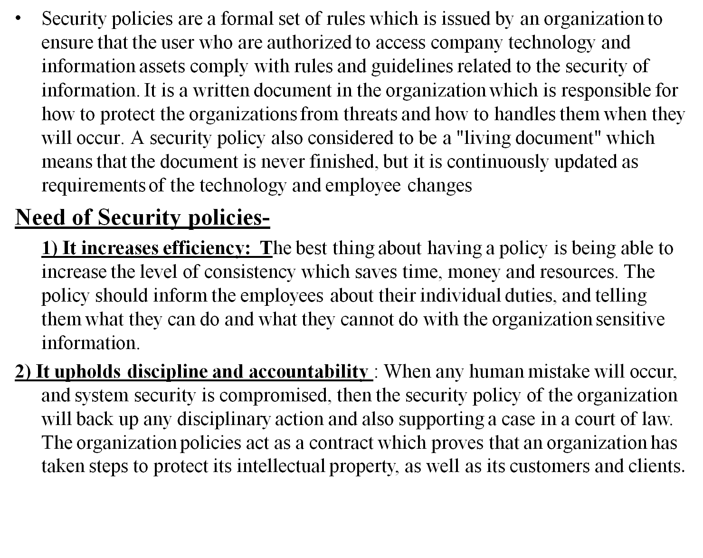
Security Policies

Slide 3
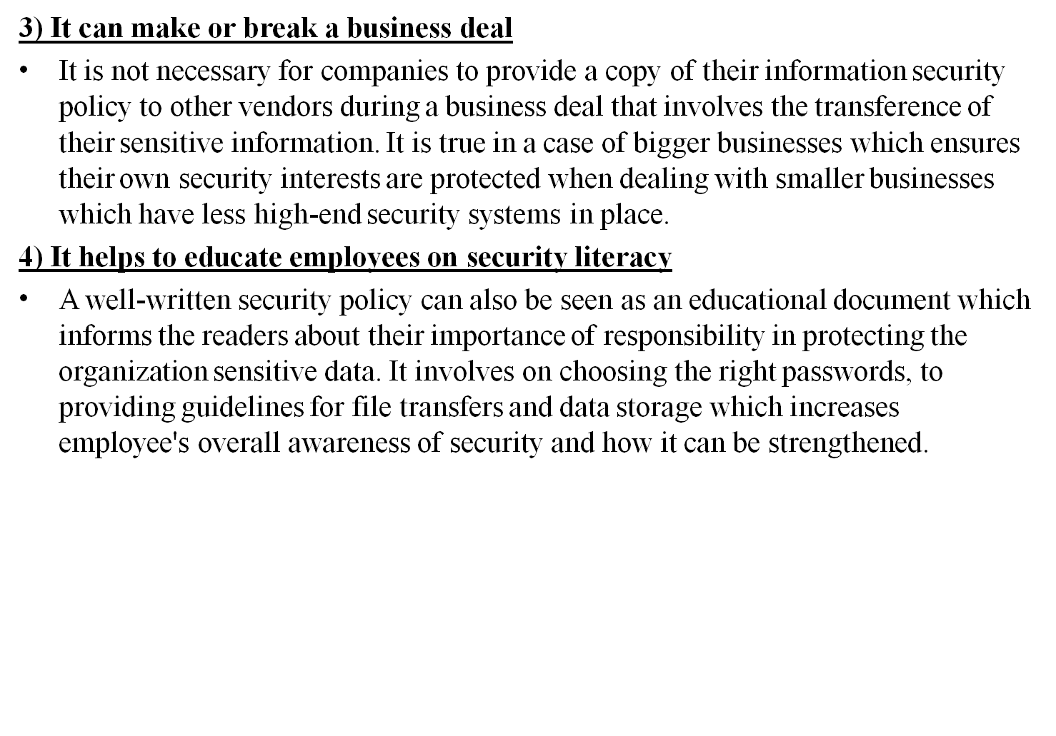
Security Policies

Slide 4
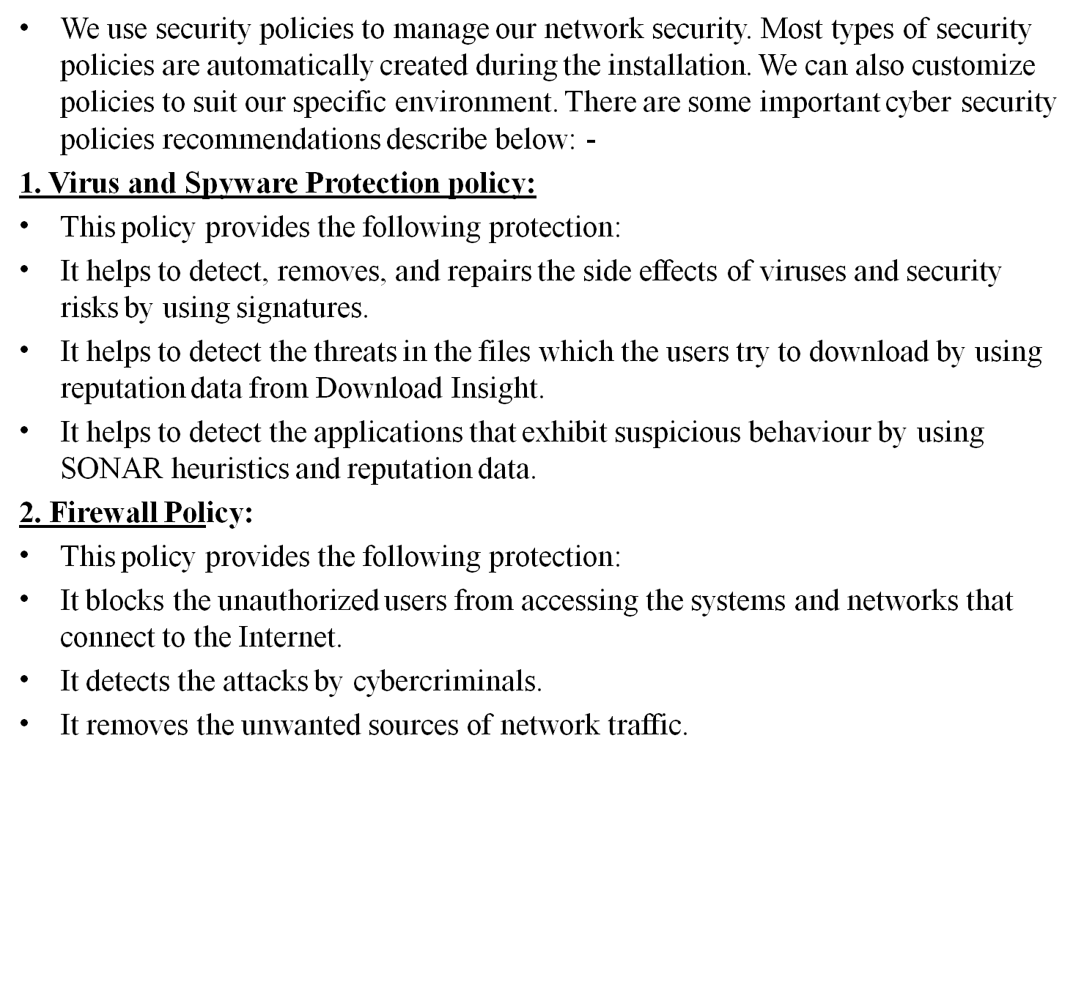
Security Policies

Slide 5
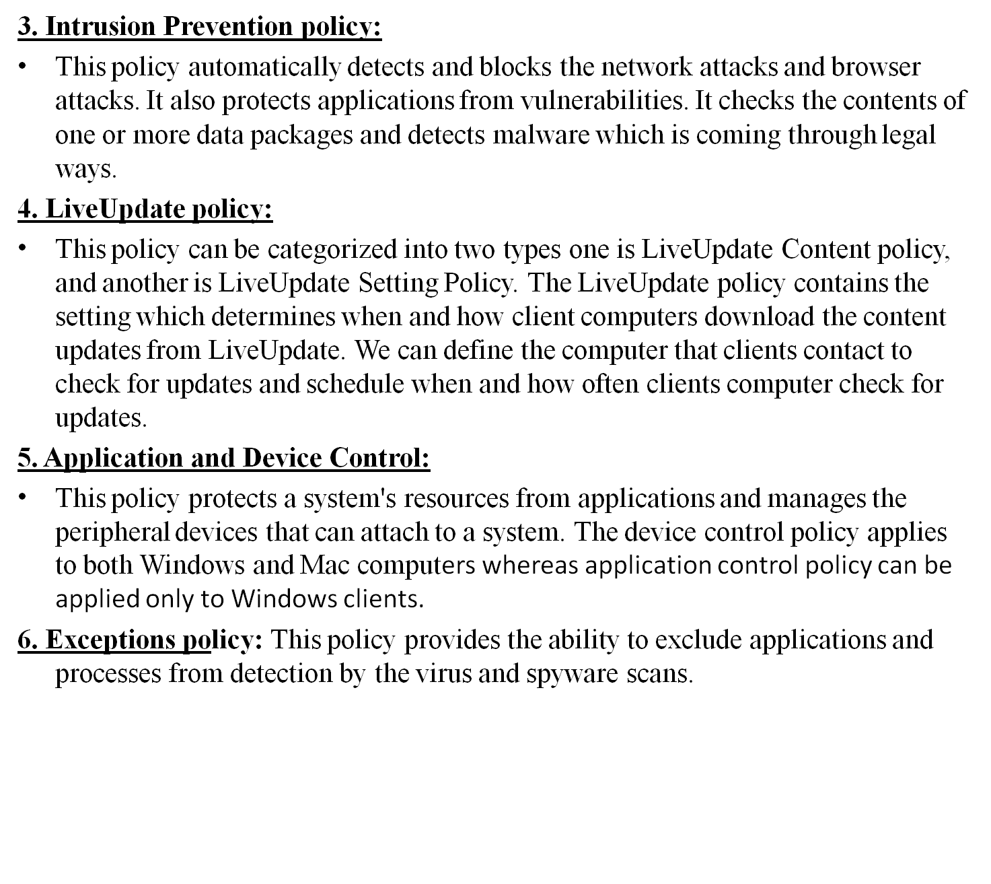
Security Policies

Slide 6
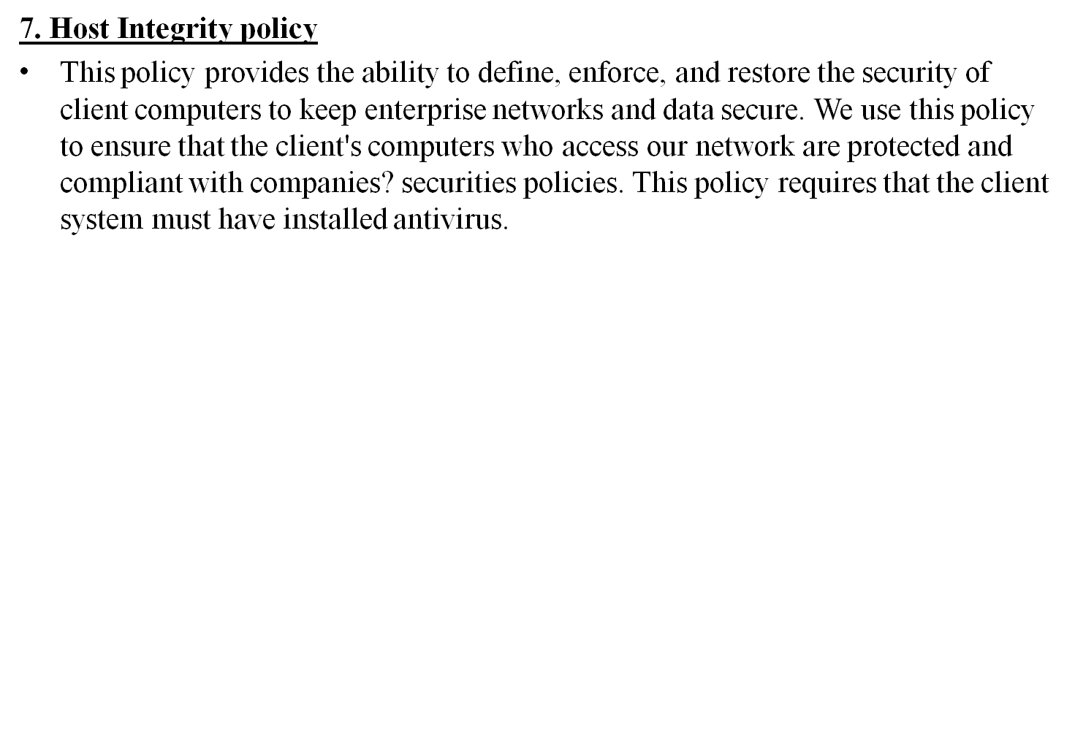
Security Policies

Slide 7
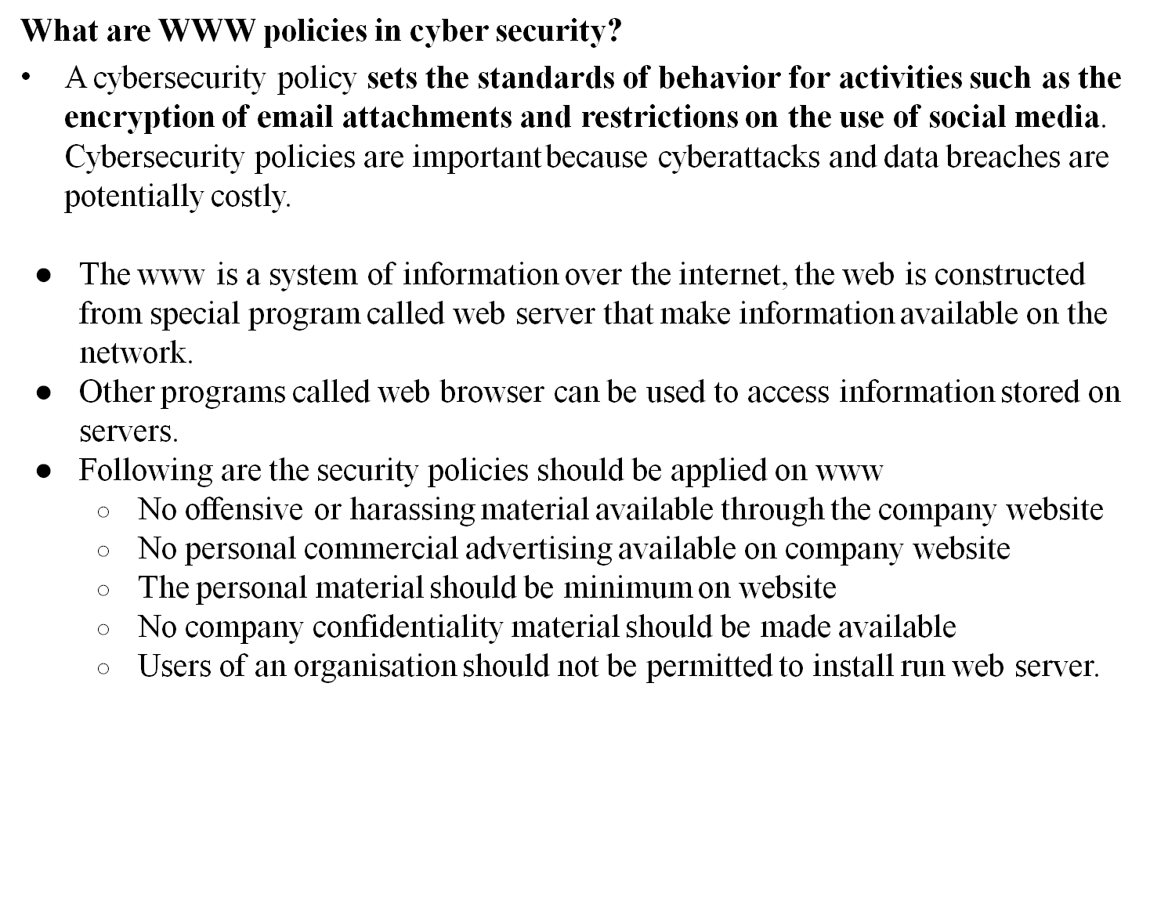
WWW Policies

Slide 8
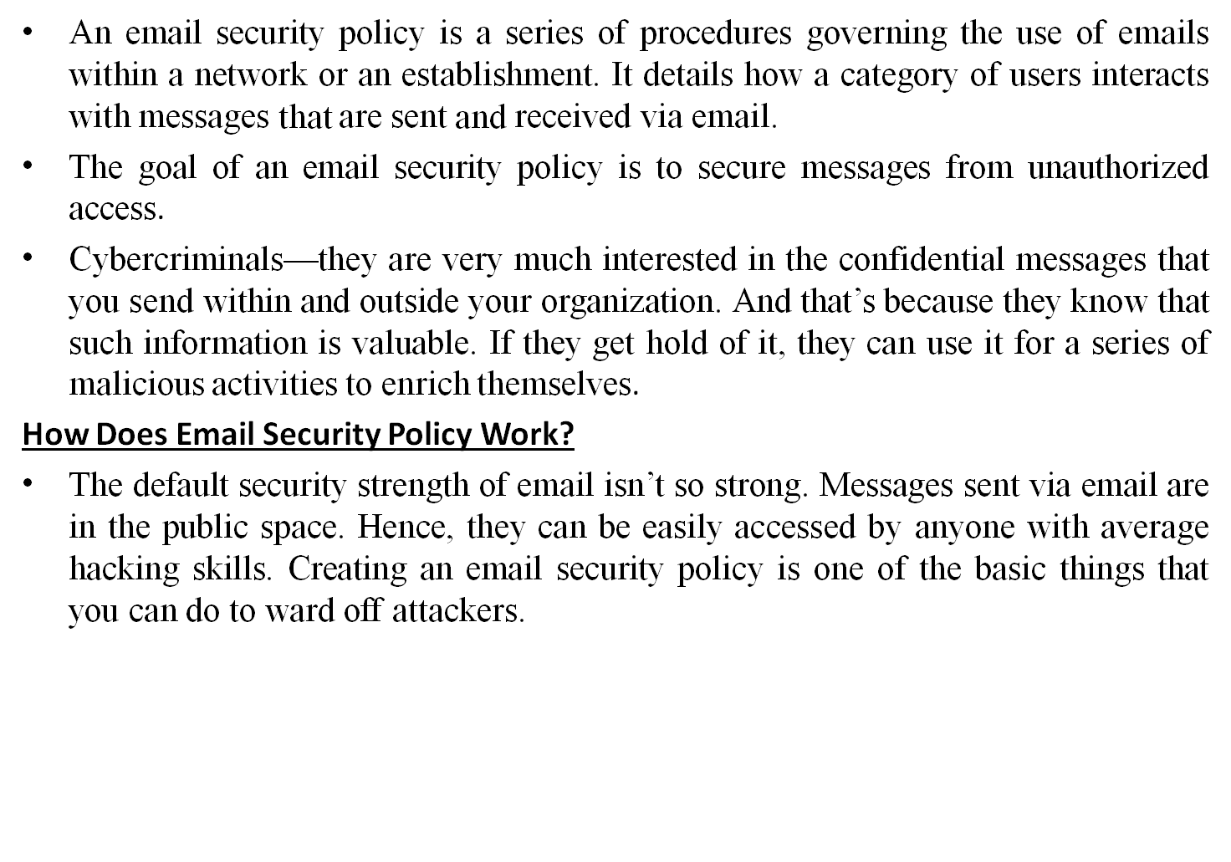
E-Mail Security Policies

Slide 9
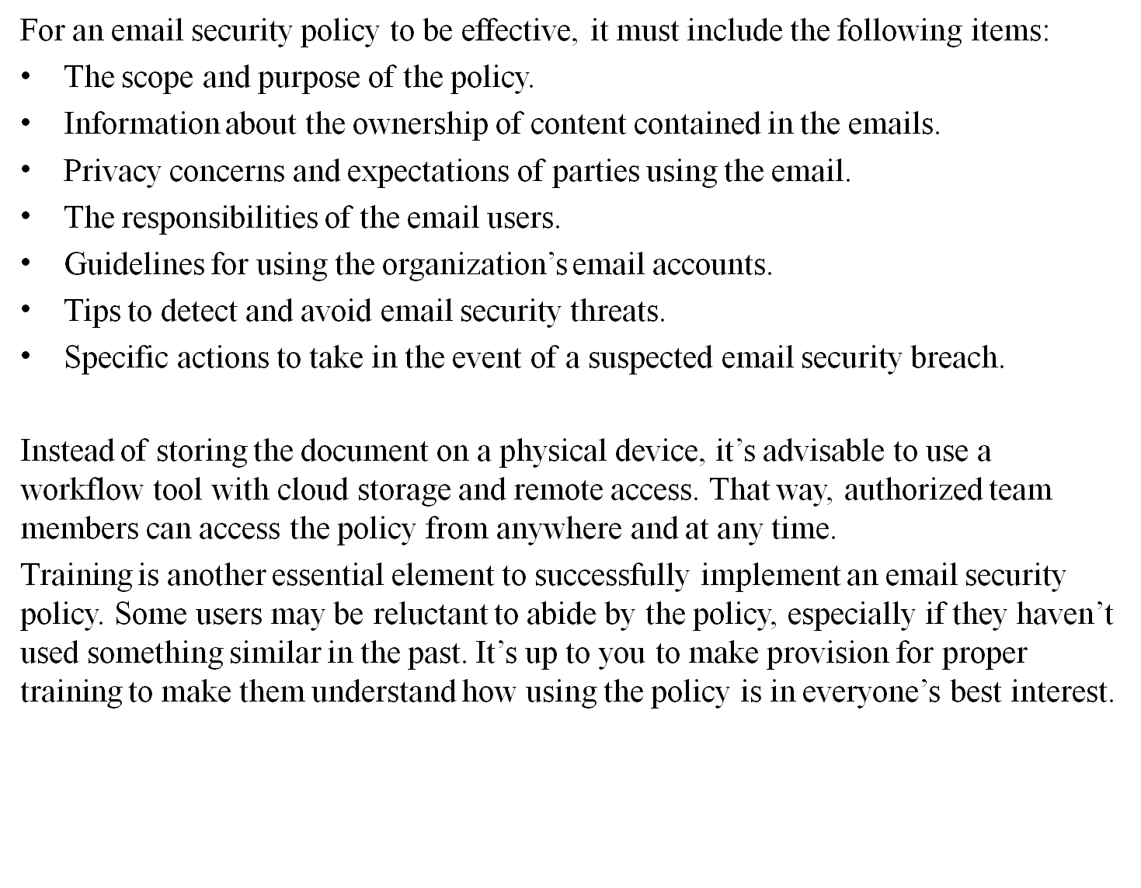
E-Mail Security Policies

Slide 10
E-Mail Security Policies
How to Build an Effective Email Security Policy
An email security policy isn’t one-size-fits-all because no two organizations are the same. But the cyber threats that endanger the use of emails have similar effects on organizations regardless of their offerings and sizes. They are common attributes that should be considered in building a standard policy.
Here are some practical tips for building an email security policy that works.
1. Adopt a Template : Creating an email security policy from scratch isn’t a bad idea, but you could save yourself some time by adopting an existing template. This is necessary, especially if you aren’t familiar with the content of the policy.
2. Modify the Template : Adopting an existing template doesn’t mean you should use it the way it is. The template is to give you an idea of what the policy looks like.
Instead of taking everything contained in the template hook line and sinker, adjust it to suit the unique needs of your business.
3. Identify User Engagement Terms: Users of your email may engage in indiscriminate activities if they aren’t aware that such activities are prohibited. It's your responsibility to expressly state how they should use your email. Identify unhealthy email practices that may expose your network to cyber attacks and warn against involving in such activities.

Slide 11
E-Mail Security Policies
4. Implement a Tool: Your email security policy is incomplete without implementing a tool that enhances the security of your emails. Manually protecting your email against cyber threats is insufficient, especially as cybercriminals use advanced technologies for their attacks. Match their energy with tools such as sandboxes, spam filters, and malware prevention software.
5. Enforce User Policy Acknowledgement : The successful implementation of your policy begins with your users’ willingness to abide by it. Change comes with some resistance. Team members who aren’t familiar with an email security policy may decide to overlook it.
6. Train Users : Users of your email may not understand some information in the policy. Leaving them in a state of confusion is risky as they may take inappropriate actions that will endanger your network. Ensure that everyone understands the policy by conducting training.
7. Develop an Incident Response Plan : Even with all the training on how to implement an email security policy effectively, things might still go wrong.

Slide 12
Policy Review Process
The goal is to give independent confirmation whether the organizations are doing the right things and to help organizations improve.
Why do you need a policy review process?
Outdated policies can leave your organization at risk. Old policies may fail to comply with new laws and regulations. They may not address new systems or technology, which can result in inconsistent practices. Can you imagine a policy that still addresses whether you can bring in floppy disks from home or discusses the proper use of fax machines? Yet there are probably policy manuals out there that still have this information in them.
When to conduct a review
conduct a review on any organization that has a security team and that has started creating an information security policy.
The review is most often requested by the management of the organization.
It can also be requested by a stakeholder such as a customer or potential investor.
In each case we try to understand what the goals of the information security team are and which standard they are using, so that we use the right standard as the basis for the review.

Slide 13
Policy Review Process
policy review is most effective when it's done regularly and proactively, not in reaction to an event (more on that in a minute). Don't wait for a problem or violation to decide to review your company policies. If you had an ongoing review process, you could confidently address any issues or events that you face, and head off a lot of potential problems.
Security review process
Intake: A meeting between management or information security team of the organization and a senior reviewer to determine the goals, scope, approach and timeline for the review.
Preparation: the information security team collects the information security policy documents and process descriptions and sends it (securely) to the review team. The review team analyses the documents and prepares questions
Site visit: The review team (consisting of two information security experts) visits the organization on site, interviews the information security team, inspects additional documents/evidence and asks control questions to management or staff during an office inspection

Slide 14
Policy Review Process
4. Issue resolution. The review team shares the initial findings and suggested improvements with the information security team. The information security team has to handle each finding within two weeks and report back how each issue has been handled. Ways of handling issues are to either take immediate action, plan an action, modify a policy, or add the issue to a backlog so that it is resolved within reasonable time via an already existing improvement process.
5. Report creation. The review team prepares the final review report. Each expert in the review fills in the checklist of criteria objectively, based on their own observations. If all criteria are met, they can conclude that the organisation qualifies for a certificate.
6. Final results and possibly certification. The organisation receives the final review report. If the organisation qualifies according to the review report, a ‘Security Verified‘ certificate can also issued.

Slide 15
Policy Review Process
Corporate Policy:
Corporate policy is formal declaration of principles and procedures according to which a company will operates those principle and guidelines are executed by board of directors, company senior management, policy committee.
Corporate policies may appear heavy and complicated. In present scenario, corporate policies are essential even for businesses seeking to do things in a different way. Without proper policies, it will become extremely tough for the business to continue and policies work as guide and help the manager to direct all the actions towards the same goal.
A corporate policy includes
Company mission statement
Company objective
Principles on the basis of which strategic decisions are made.

Slide 16
Policy Review Process
What is the Importance of Corporate Policy?
Policies are necessary to perform the business activities in a smooth way.
Corporate polices offer clear cut courses for achievement of organizational goals.
If an appropriate explicit policy has been developed, most of the details can be easily taken care of by the employees and management would not needlessly spend its time as well as energy in performing such tasks.
Corporate Policies present you with instructions and a platform for making decisions.
Policies promote delegation of the power of making decisions.
Properly formulated corporate policies give a direction in which all management pursuits are targeted.
Policies provide steadiness to the action of the members of the organization.
Policies and guidelines prevent the subordinates to rethink on the day to day challenges and therefore prevent repeated analysis of problems.
Policies help in analysis of performance by serving as a standard.
Corporate policies boost employees’ commitment and loyalty for the business.
It helps in dealing with the issues for optimal utilization of limited resources.

Slide 17
Policy Review Process
What is the Importance of Corporate Policy?
Sound policies aid in developing good public image of an organization.
Corporate Polices give the organization clear targets so that the managers can decide regarding the future plan of action.
They act as tool for co-ordination and control.
Thus we can say that corporate policy is significant for a corporation. It helps in the all round development and growth of the organization. A sound corporate policy gives satisfaction to the workers with regards to working conditions, organizational culture, authority, and responsibility.

Slide 18
Policy Review Process
Sample Security Policy:
The information security policy
  Aim
  Purpose
  Responsibilities of User
Risk Assessment & classification
  Risk assessment of information and personal data.
Protection of information system and assess
Protection of confidential information
Risk Identification and Analysis
  Threats and Risks
Appendix
  Sample Risk Assessment
glossary

Slide 19
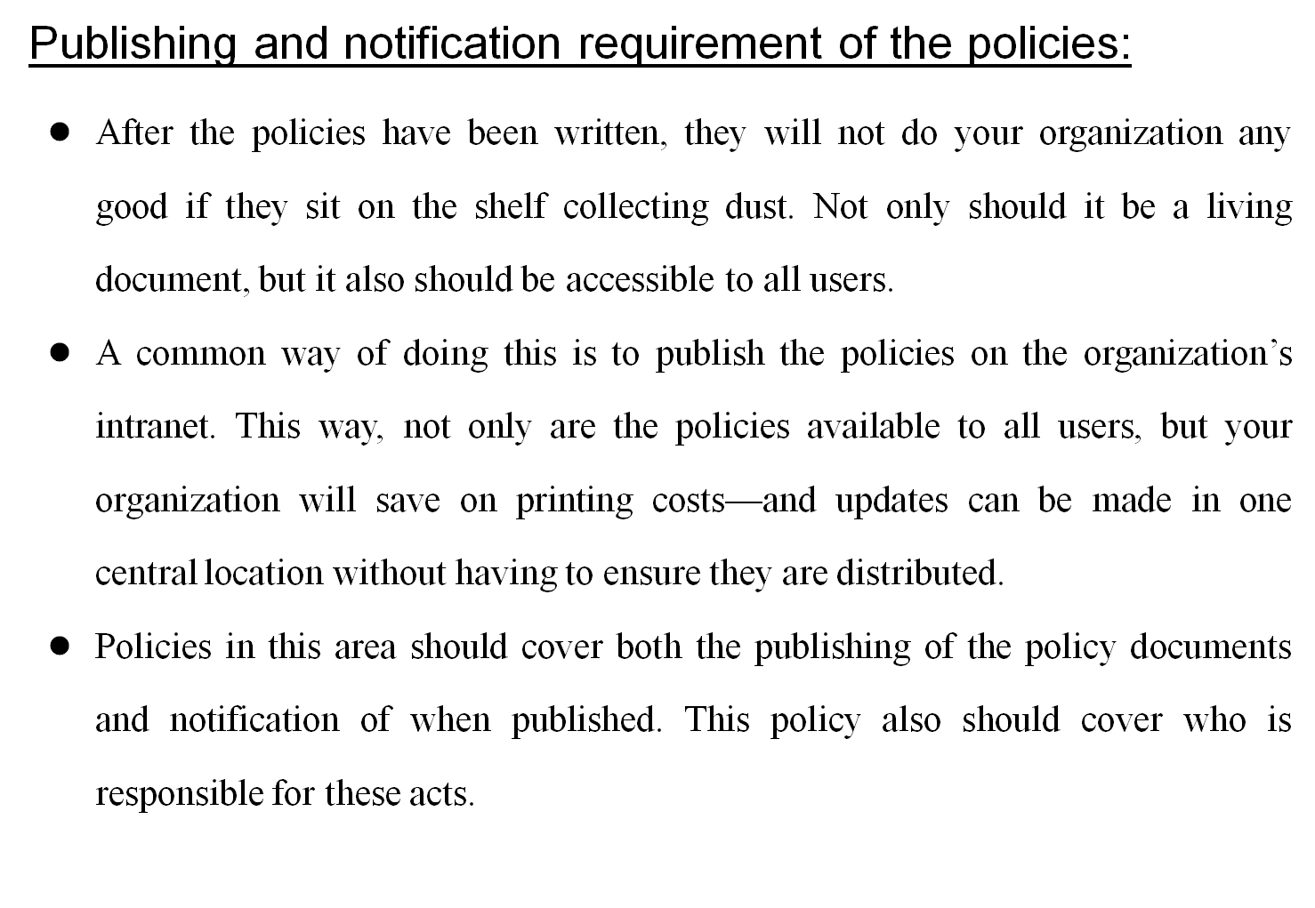
Policy Review Process

Slide 20
Information Security Standards
To make Cyber Security measures explicit, the written norms are required. These norms are known as standards.
The standards may involve methods, guidelines, reference framework etc.
The stands include requirements for developing Information Security management System (ISMS), implementing security controls, and conducting risk assessments.
The goal of security standards is to improve the security of IT systems, network and critical infrastructure.
Security standards are provided for all the organizations regardless of the size or the industry and sector in which they operate.
ISO :
It stands for International Organization for Standardization. International standards make things to work.
These standards provide world class specifications for products, services, and computers to ensure quality, safety and efficiency.
ISO standard officially established on 23/02/1947. it is an independent, non-governmental international organization.

Slide 21
Information Security Standards
Today it has a membership of 162 national standard bodies, and 784 technical committees & sub-committees to take care of standard development.
ISO has published over 22336 international standards and its related documents which covers almost every industry from IT to agriculture & Healthcare.
a) ISO 27000 series:
it is the family of ISO standard which is developed by the ISO and the IEC(International Electro-technical Commission) to provide globally recognized framework for best IT management.
The need of ISO 27000 series arise because of risk of cyber attacks which the organization face.
The ISO 27000 series categorized into many types they are:
i) ISO 27001: this standard allows us to prove clients & stakeholders for any organization to managing the best security of their confidential data and information. This standard involve a process-based approach establishing , implementing, operations , monitoring and maintaining and improve our ISMS.
ii) ISO 27000: this standard provides an explanation of terminologies used in ISO 27001

Slide 22
Information Security Standards
iii) ISO 27002: This standard provides guidelines for organizational IS standards and IS management practices. IT includes selection, implementation, operating and management of controls taking into consideration of organizational IS risk environment.
iii) ISO 27005: This standard supports general concepts specification 27001. It is designed to provide the guidelines for implementation of IS based on a risk management approach.
To completely understand the ISO/IEC 27005, the knowledge of the concepts, models, processes and terminologies described in ISO/IEC 27001, and ISO/IEC 27002 is required.
iii) ISO 27032: it is the international standard which focuses explicitly on cyber security. This standard includes guidelines for protecting the information beyond the borders of an organization such as in collaborations, partnerships or other information sharing arrangements with clients and suppliers.

Slide 23
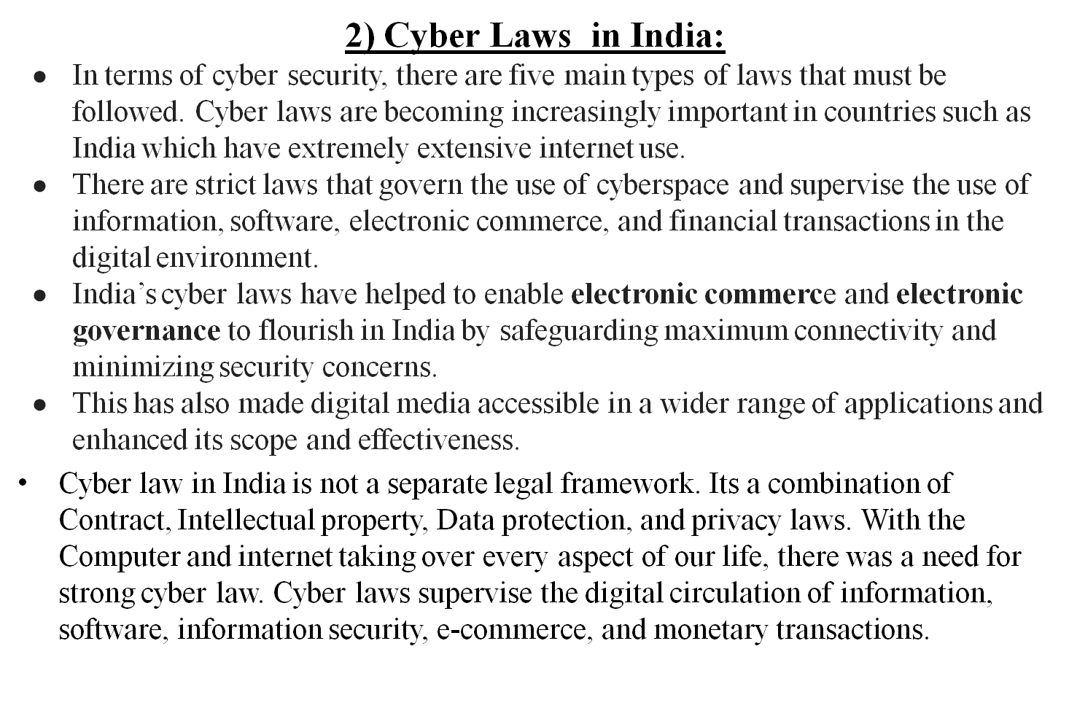
Information Security Standards

Slide 24
Information Security Standards
The Information Technology Act, 2000 addresses the gamut of new-age crimes. Computer technology, mobile devices, software, and the internet are both medium and target of such crimes.
All Traditional criminal activities are such as theft, fraud, forgery, defamation, and mischief are part of cyberspace. These were addressed in the Indian Penal Code already.
Importance of Cyber Law in India
Cyber laws in India or cybercrime law in India are important because of the prime reason that cybercrime act in India encompasses and covers all the aspects which occur on or with the internet - transactions, and activities which concern the internet and cyberspace.
"The Cyber Laws in India has paved the way for electronic commerce and electronic governance in the country by ensuring maximum connectivity and minimum cyber security risks. Also, enhancing the scope and expanding the use of digital mediums,"

Slide 25
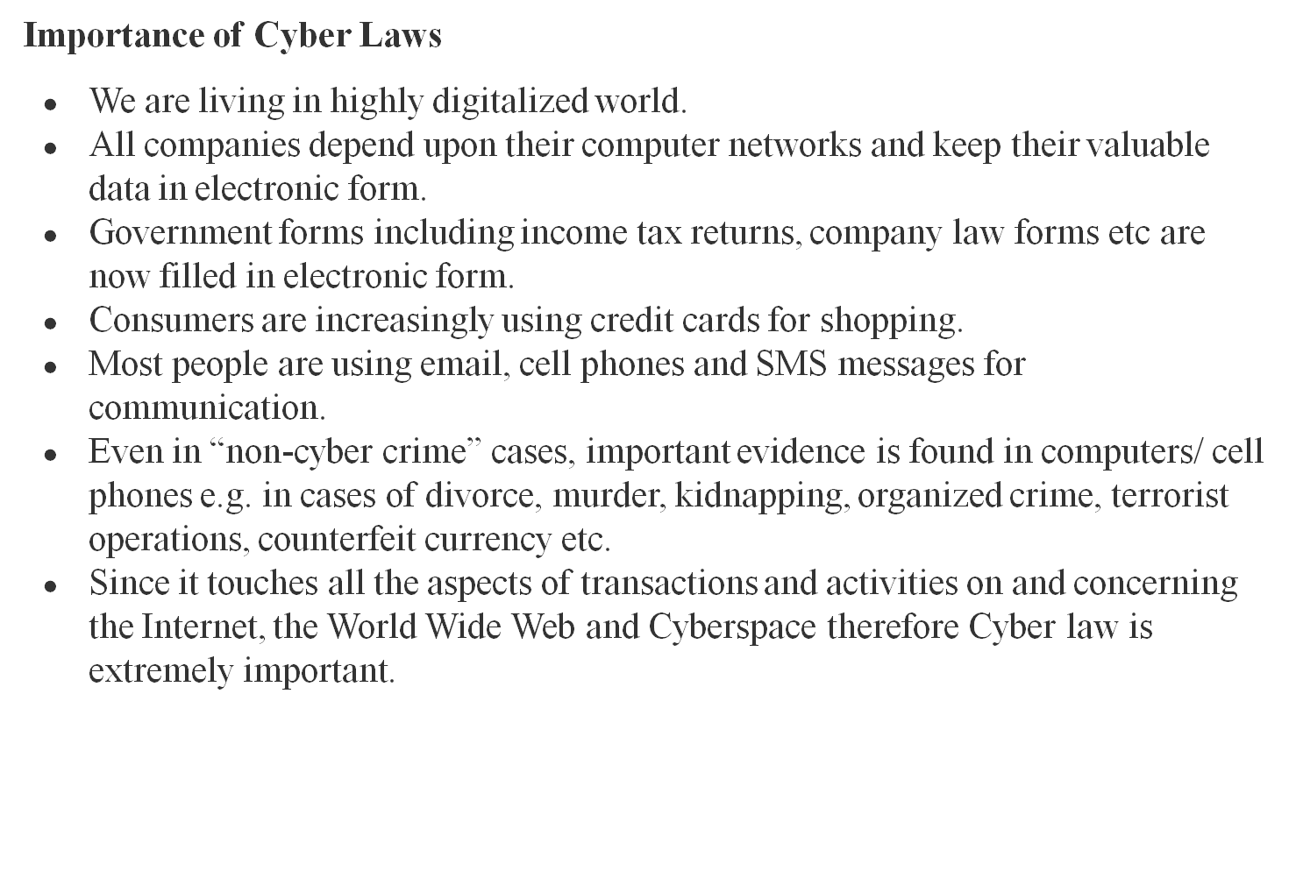
Information Security Standards

Slide 26
Information Security Standards
Evolution of Cyber Law in India
With an increase in the dependency on the use of technology, the need for cyber law was necessary. Much like every coin has two sides, therefore, the dependency on technology has its pros and cons. The rise of the 21st century marked the evolution of cyber law in India with the Information Technology Act, 2000 (popularly known as the IT Act). The first-ever cybercrime was recorded in the year 1820
The objective of the Information Technology Act in India is as follows:
To provide legal recognition for all e-transactions
To give legal recognition to digital signatures as a valid signature to accept agreements online
To give legal recognition to keeping accounting books in electronic form by bankers as well as other organizations
Protection of online privacy and stopping cyber crimes
The Indian IT law updated the Reserve Bank of India Act and the Indian Evidence Act. With the evolution of cyberlaw, almost all online activities came under scrutiny.

Slide 27
Information Security Standards
However, one thing about cyber law is that there are certain areas on which cybercrime laws in India do not apply such as:
Negotiable Instrument being other than cheque
Power of Attorney
Will
The contract for Sale or Conveyance of Immovable Property
Central Government notified documents or transactions
The Need for Cyber Laws
In the present world which is more tech-savvy, the words cyber law and cyber crimes have also become more sophisticated. Internet and technology were launched for research purposes and making the lives of humans easy but as the use and number of people on the internet increased, the need for cyber laws in India was felt. As the nature of the internet is anonymous it is easy to commit cybercrimes. Thereby many could misuse this aspect largely.

Slide 28
Information Security Standards
3) IT Act 2000 Provisions:
The information Technology Act also known as IT ACT-2000 or the IT Act main aims is to provide the legal in fracture in India which deal with cyber crimes and E-commerce. The IT Act is based on the Unites Nations Model Law on E-Commerce 1996 recommended by the general assembly of United Nations.
This act also used to check misuse of cyber networks and computers in India.
It was officially passed in 2000 and amended in 2008.
It has been designed to give the boost to E-Commerce, E-Transactions and related activities associated commerce and trade.
IT Act 2000 has 13 chapters, 94 sections and 4 schedules. The first 14 sections concerning Digital Signature and other sections deal with the certifying authorities who are Licensed to issue the Digital Signature certificate.
Section 43 to 47 provide penalties and compensation, section 48 to 64 deal with appeal to High court, and section 65-79 deal with offences and remaining sections from 80 to 94 deal with miscellaneous of the act.

Slide 29
Information Security Standards
The Information Technology Act, 2000 was enacted by the Indian Parliament in 2000. It is the primary law in India for matters related to cybercrime and e-commerce.
The act was enacted to give legal sanction to electronic commerce and electronic transactions, to enable e-governance, and also to prevent cybercrime.
Under this law, for any crime involving a computer or a network located in India, foreign nationals can also be charged.
The law prescribes penalties for various cybercrimes and fraud through digital/electronic format.
It also gives legal recognition to digital signatures.
The IT Act also amended certain provisions of the Indian Penal Code (IPC), the Banker’s Book Evidence Act, 1891, the Indian Evidence Act, 1872 and the Reserve Bank of India Act, 1934 to modify these laws to make them compliant with new digital technologies.
In the wake of the recent Indo-China border clash, the Government of India banned various Chinese apps under the Information Technology Act.

Slide 30
Information Security Standards
The IT Act, 2000 has two schedules:
First Schedule –
Deals with documents to which the Act shall not apply.
Second Schedule –
Deals with electronic signature or electronic authentication method.
The offences and the punishments in IT Act 2000 :
The offences and the punishments that falls under the IT Act, 2000 are as follows :-
Tampering with the computer source documents.
Directions of Controller to a subscriber to extend facilities to decrypt information.
Publishing of information which is obscene in electronic form.
Penalty for breach of confidentiality and privacy.
Hacking for malicious purposes.
Penalty for publishing Digital Signature Certificate false in certain particulars.
Penalty for misrepresentation.
Confiscation.
Power to investigate offences.
Protected System.
Penalties for confiscation not to interfere with other punishments.
Act to apply for offence or contravention committed outside India.
Publication for fraud purposes.
Power of Controller to give directions.

Slide 31
Information Security Standards
.
Sections and Punishments under Information Technology Act, 2000 are as follows :
SECTION | PUNISHMENT
Section 43 | This section of IT Act, 2000 states that any act of destroying, altering or stealing computer system/network or deleting data with malicious intentions without authorization from owner of the computer is liable for the payment to be made to owner as compensation for damages.
Section 43A | This section of IT Act, 2000 states that any corporate body dealing with sensitive information that fails to implement reasonable security practices causing loss of other person will also liable as convict for compensation to the affected party.
Section 66 | Hacking of a Computer System with malicious intentions like fraud will be punished with 3 years imprisonment or the fine of Rs.5,00,000 or both.
Section 66 B, C, D | Fraud or dishonesty using or transmitting information or identity theft is punishable with 3 years imprisonment or Rs. 1,00,000 fine or both.
Section 66 E | This Section is for Violation of privacy by transmitting image or private area is punishable with 3 years imprisonment or 2,00,000 fine or both.
Section 66 F | This Section is on Cyber Terrorism affecting unity, integrity, security, sovereignty of India through digital medium is liable for life imprisonment.
Section 67 | This section states publishing obscene information or pornography or transmission of obscene content in public is liable for imprisonment up to 5 years or fine of Rs. 10,00,000 or both.

Slide 32
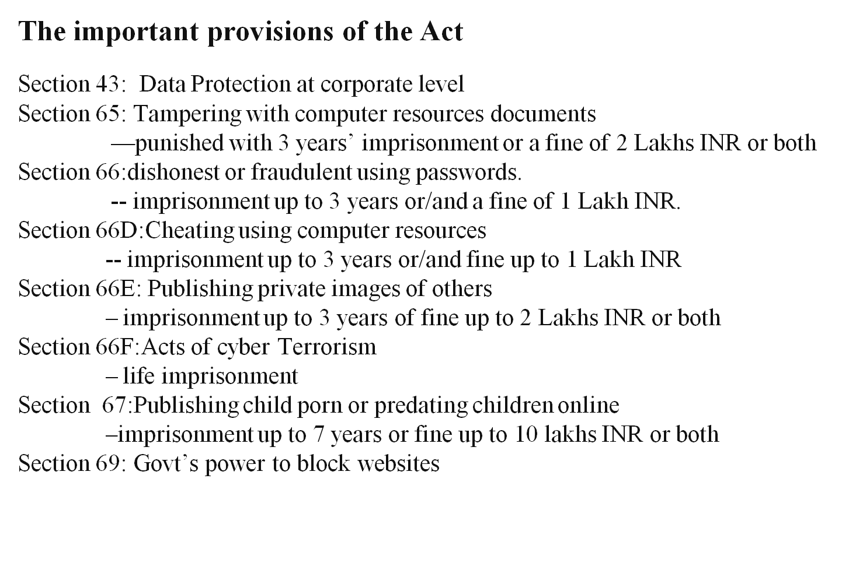
Information Security Standards

Slide 33
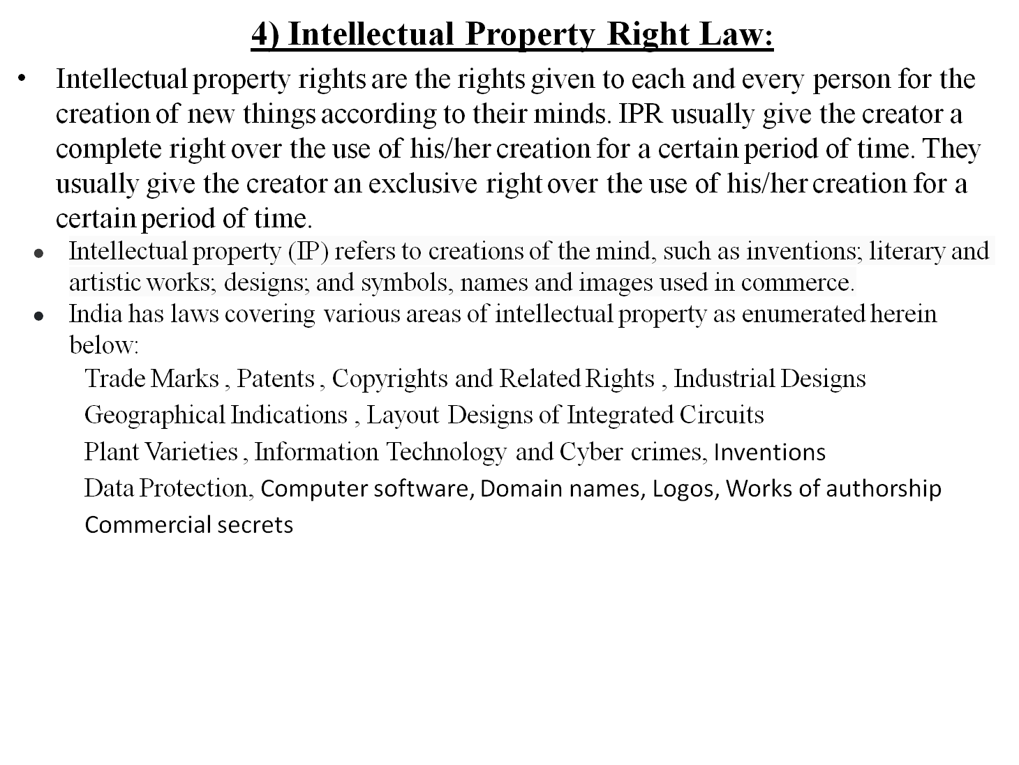
Information Security Standards

Slide 34
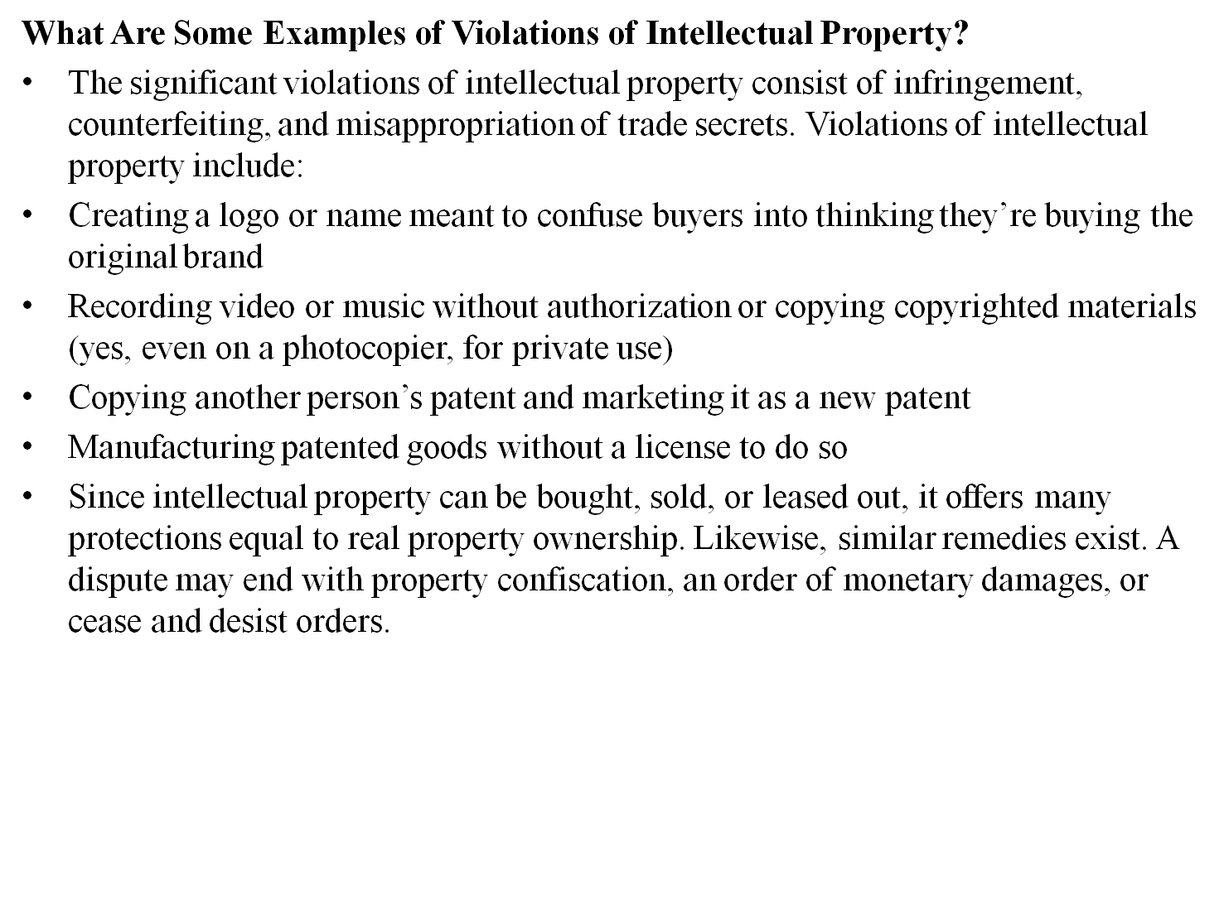
Information Security Standards

Slide 35
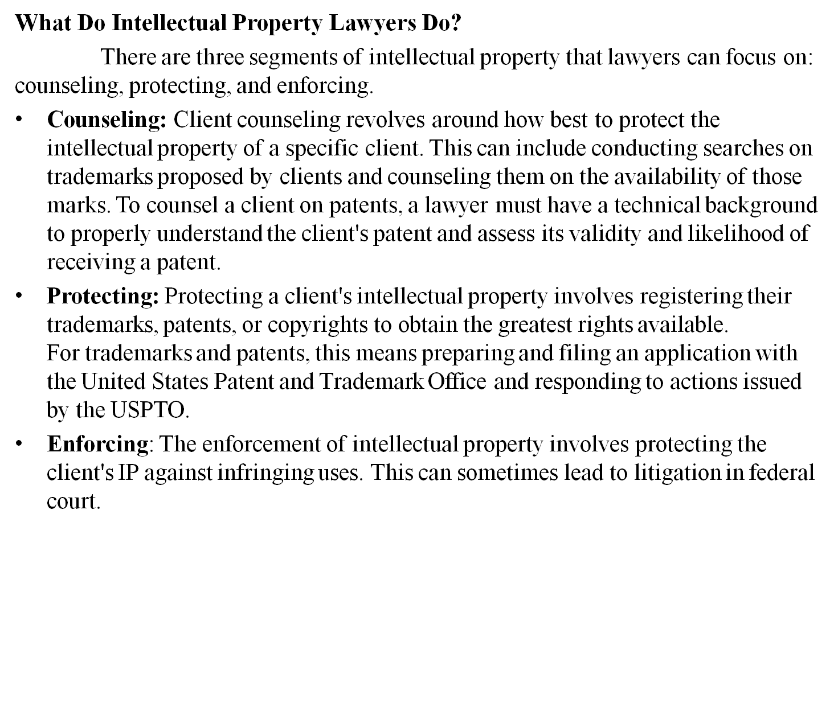
Information Security Standards

Slide 36
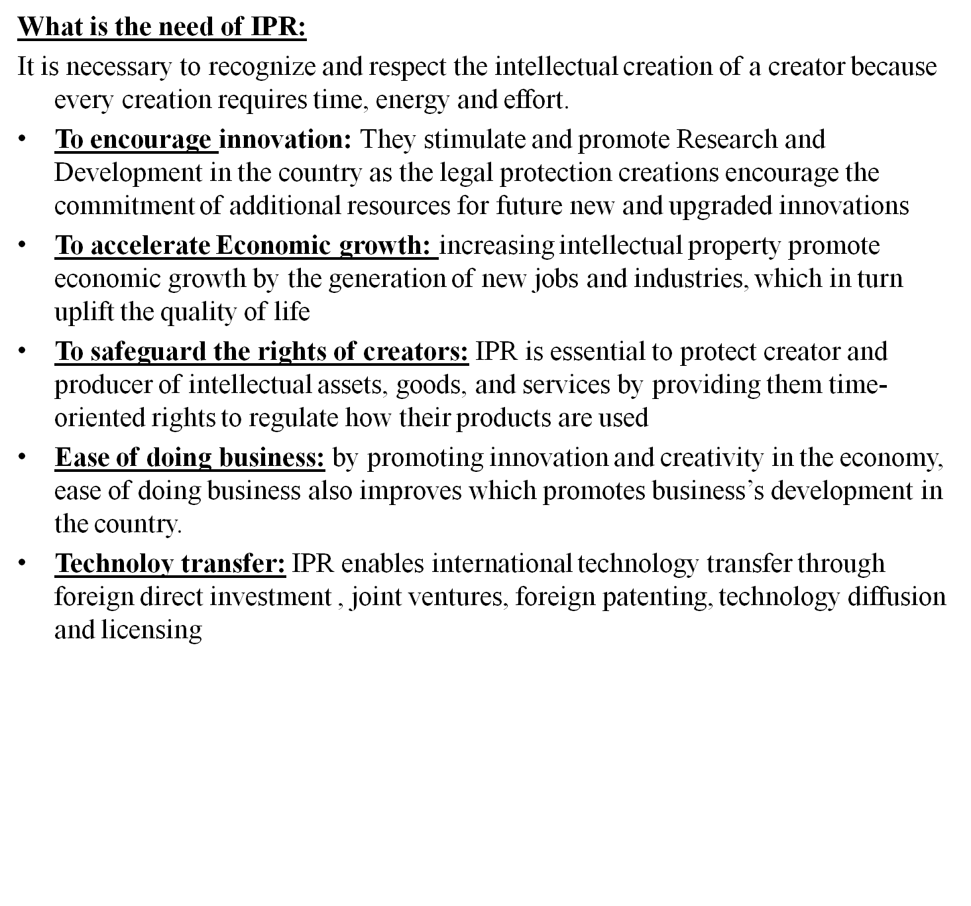
Information Security Standards

Slide 37
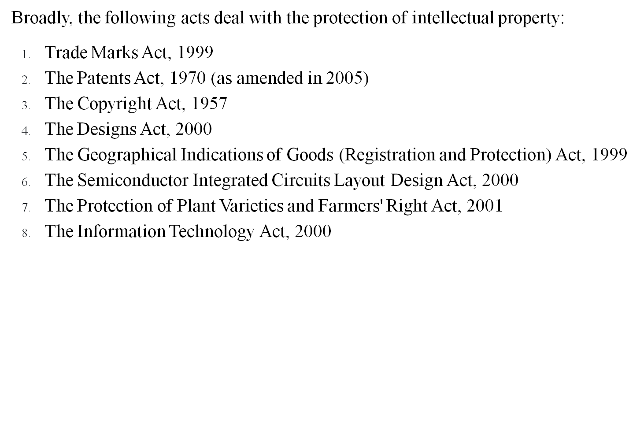
Information Security Standards

Slide 38
Information Security Standards
5) Copyright Act(Law):
The Copyright Act 1957 as amended governs the subject of copyright law in India. The Act is applicable from 21 January 1958. The history of copyright law in India can be traced back to its colonial era under the British Empire. The Copyright Act 1957 was the first post-independence copyright legislation in India and the law has been amended six times since 1957. The most recent amendment was in the year 2012, through the Copyright (Amendment) Act 2012.
The Copyright Act, 1957, governs the law pertaining to copyright in India. The major goals of this copyright law are twofold: first, to guarantee authors, musicians, painters, designers, and other creative individuals the right to their creative interpretation; and second, to enable others to openly develop upon the concepts and knowledge made available by a work.

Slide 39
Information Security Standards
What is Copyright Law?
Copyright law, described under the Copyright Law of the United States, Title 17, grants the exclusive rights to authors and artists to control how their works will be copied. The law protects the intellectual property rights of authorship for a certain number of years, legally protecting works of creative expression set in a fixed, tangible form such as a book or audio recording.
Why Copyright?? Copyright is a type of intellectual property right. Copyright ensures certain minimum safeguards of the rights of authors over their creations, thereby protecting and rewarding creativity. Creativity being the keystone of progress, no civilized society can afford to ignore the basic requirements of encouraging the same.
Copyright Definition and Example:
Copyrights allow authors to control copies made of their work or how a work is made public. An author can be an individual or a company or someone who is hired to create a work for someone else (called a 'work made for hire'). The copyright law allows the holder of a copyright to authorize someone else to make the work public. For example, book authors may allow their manuscripts to be published by a publishing company or dramatists may allow their plays to be performed on stage.

Slide 40
Information Security Standards
Nature of copyright:
In nature, copyright is an incorporeal property. The premise that the legitimate owner developed or created the work justifies the property in it. The property owner has two options for disposing of his property: outright sale (assignment of his rights) or licensing. Copyright is also a collection of exclusive rights. A negative right is one that allows the owner to stop someone from copying his creation or carrying out any other actions that, under Copyright Law, are only permitted to be carried out by him. The exclusive rights to works protected by copyright have a term limit. In contrast to physical property, which endures for the lifetime of the thing on which it is bestowed, copyright only exists for a finite amount of time. After this time period has passed, the work enters the ‘public domain’. In other words, it becomes public property and is available for use without restriction by everyone.

Slide 41
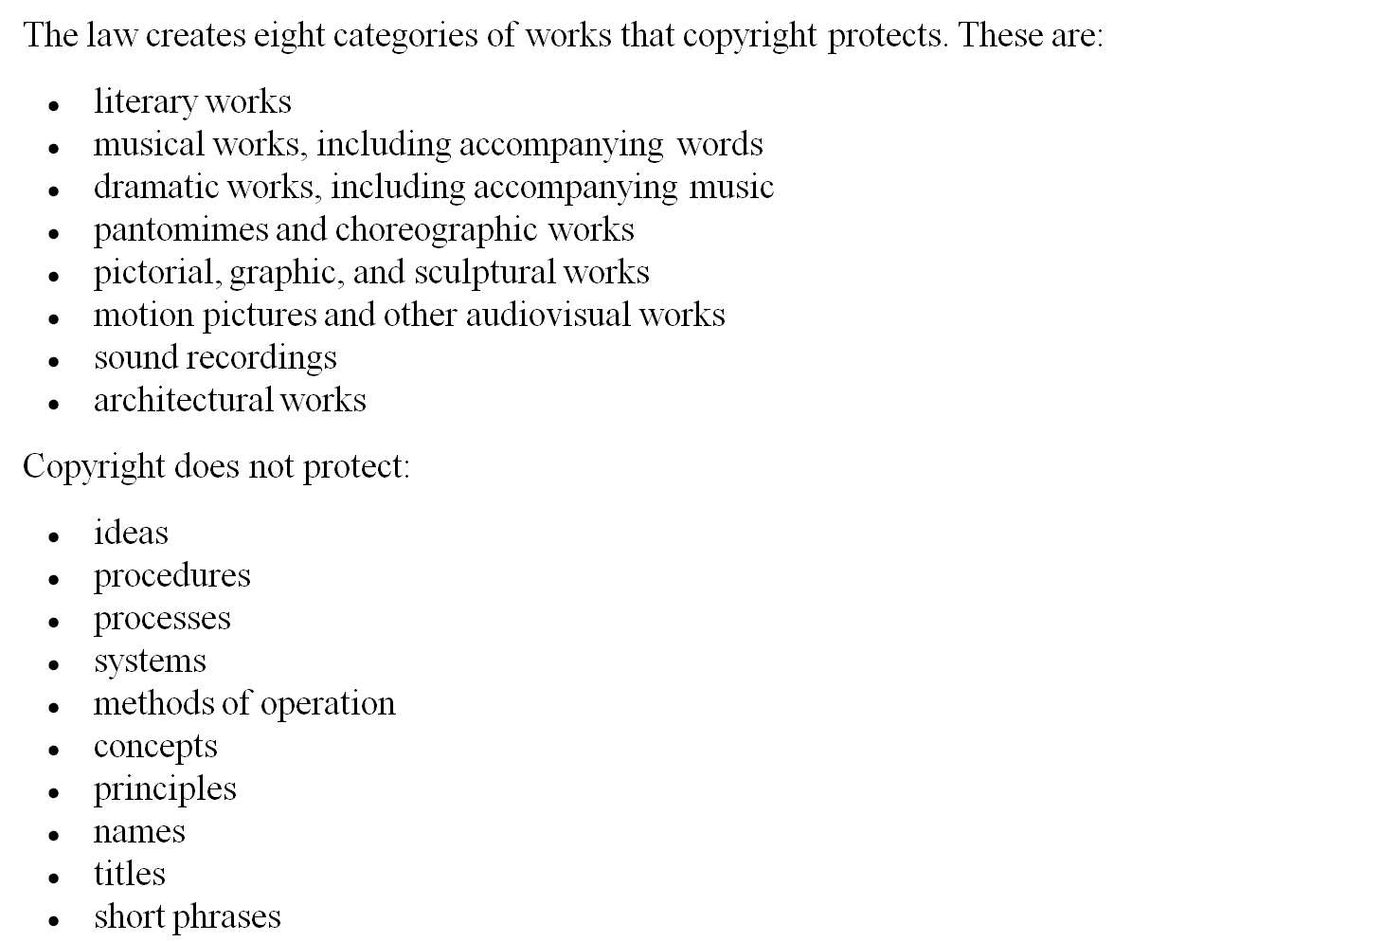
Information Security Standards

Slide 42
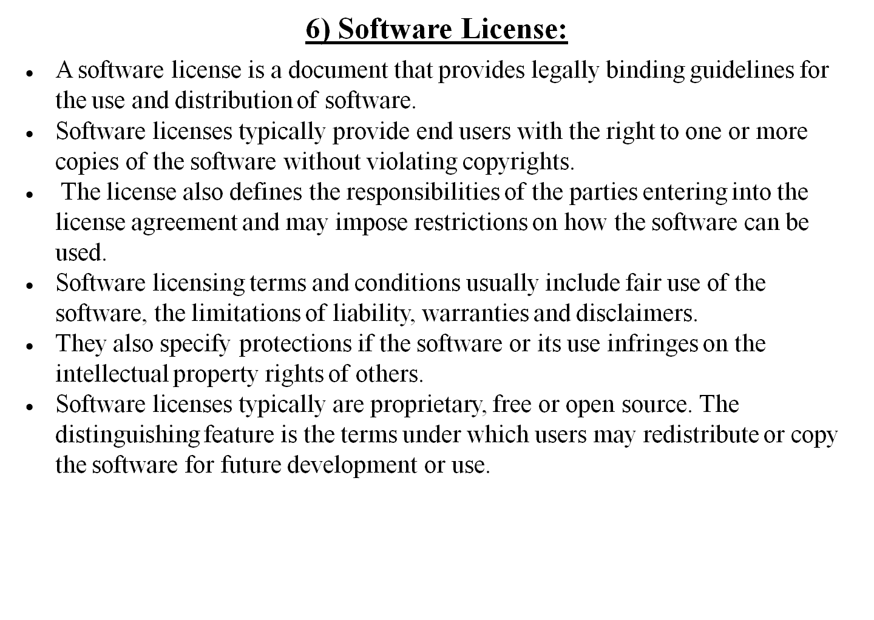
Information Security Standards

Slide 43
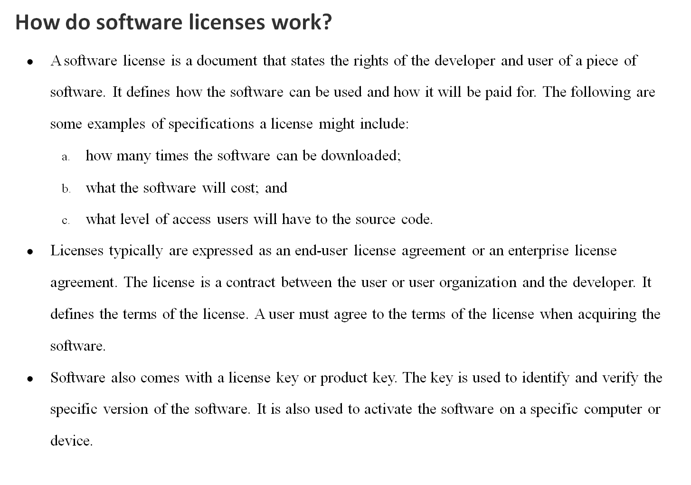
Information Security Standards

Slide 44
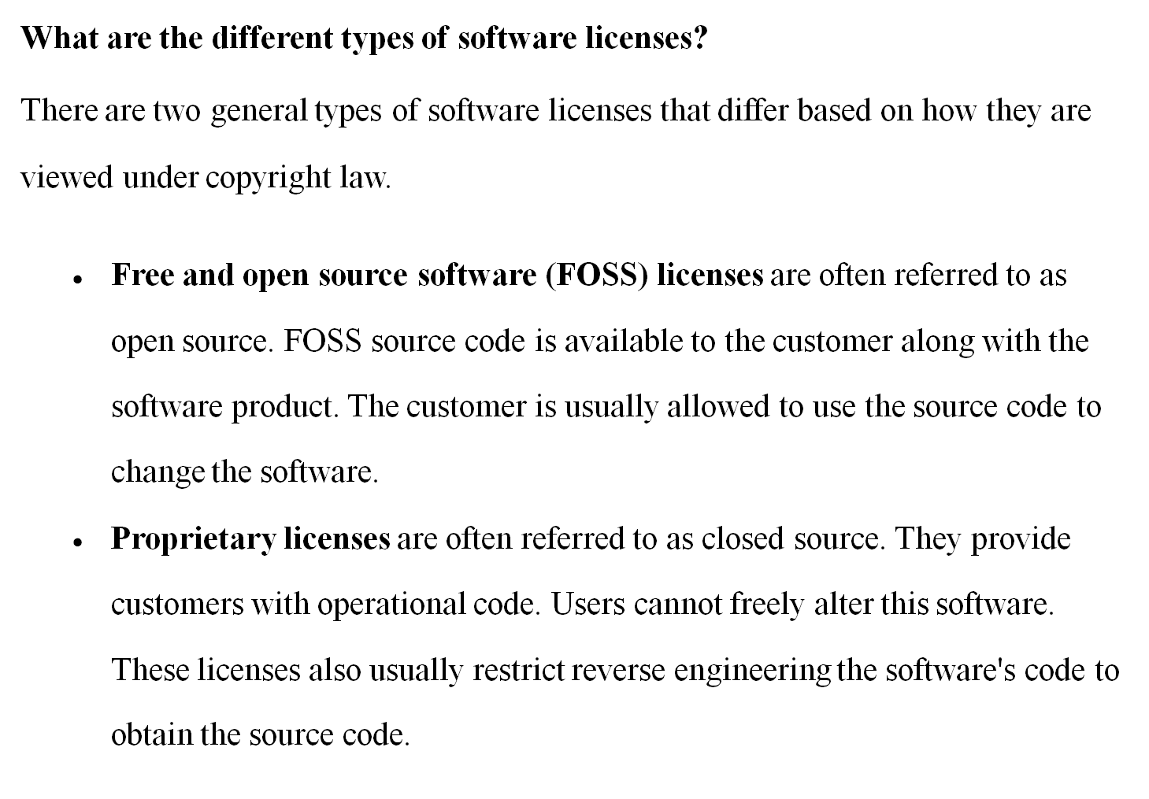
Information Security Standards

Slide 45
Information Security Standards
7) Semiconductor Law:
Semiconductor protections
Purpose : Fill the gap between copyright and patent law
Not covered by patents
Not covered by copyright
What protects the semiconductor then?
  Semiconductor chip protection act of 1984.
  High specialized intellectual property form
  Creates registered mask work
  First new IP right created in ~100 years
  Copyrights like right protected for 10 years only

Slide 46
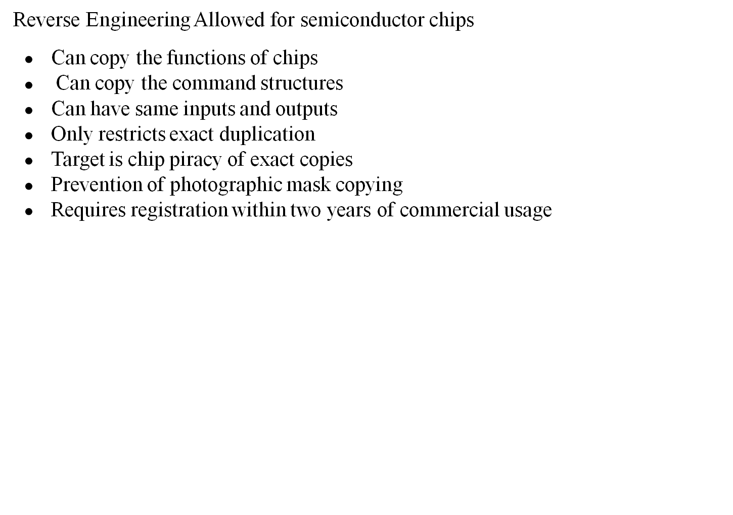
Information Security Standards

Slide 47
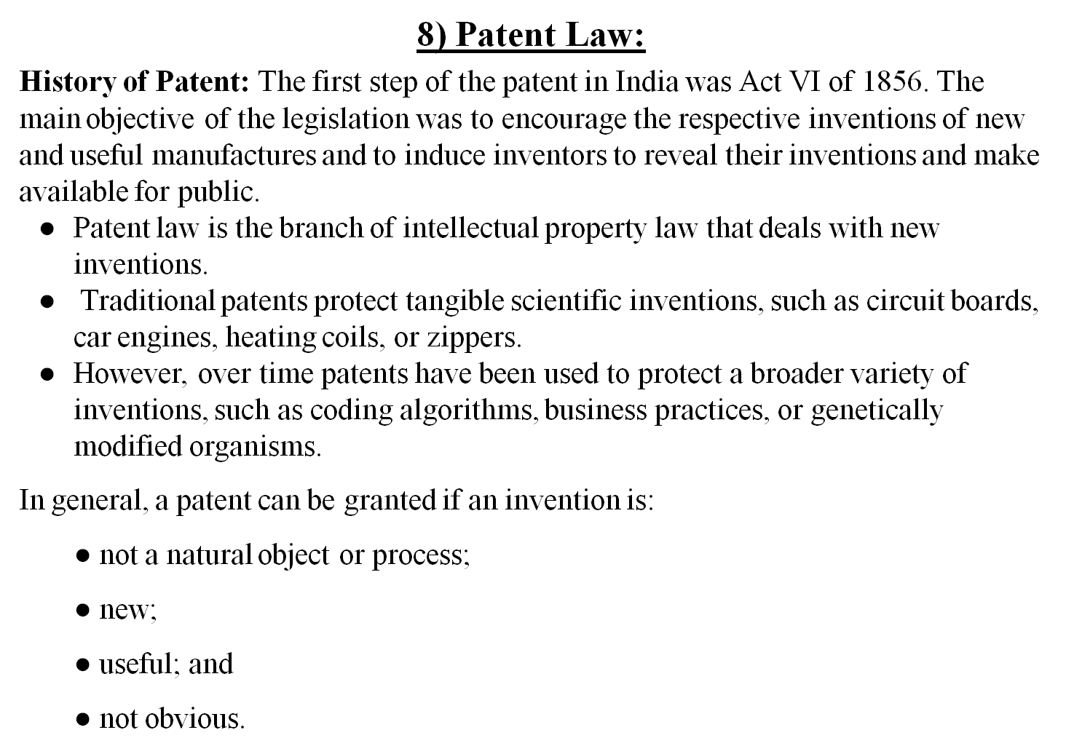
Information Security Standards

Slide 48
Information Security Standards
A patent is an exclusive right granted by the Government to the inventor to exclude others to use, make and sell an invention is a specific period of time. A patent is also available for improvement in their previous Invention. The main motto to enact patent law is to encourage inventors to contribute more in their field by awarding them exclusive rights for their inventions.
There are three basic tests for any invention to be patentable:
Firstly, the invention must be novel, meaning thereby that the Invention must not be in existence.
Secondly, the Invention must be non- obvious, i.e. the Invention must be a significant improvement to the previous one; mere change in technology will not give the right of the patent to the inventor.
Thirdly, the invention must be useful in a bonafide manner, meaning thereby that the Invention must not be solely used in any illegal work and is useful to the world in a bonafide manner.

Slide 49
Information Security Standards
What can be patented?
There are certain criteria which have to be fulfilled to obtain a patent in India. They are:
Patent subject:
The most important consideration is to determine whether the Invention relates to a patent subject matter. Sections 3 and 4 of the Patents Act list non-patentable subject matter. Unless the Invention comes under any provision of Section 3 or 4, it means that it consists of a subject for a patent.
Novelty:
Innovation is an important criterion in determining the patent potential of an invention. Under Section 2(l) of the Patent Act, a novelty or new Invention is defined as “no invention or technology published in any document before the date of filing of a patent application, anywhere in the country or the world”.
Simply, the novelty requirement basically states that an invention that should never have been published in the public domain. It must be the newest which have no same or similar prior arts.

Slide 50
Information Security Standards
Inventive steps or non-clarity:
Under Section 2(ja) of the Patents Act, an inventive step is defined as “the characteristic of an invention that involves technological advancement or is of economic importance or both, as compared to existing knowledge, and invention not obvious to a person skilled in the art.” This means that the invention should not be obvious to a person skilled in the same field where the invention is concerned.
Capable of industrial application:
Industrial applicability is defined in Section 2 (ac) of the Patents Act as “the invention is capable of being made or used in an industry”. This basically means that the Invention cannot exist in the abstract. It must be capable of being applied in any industry, which means that it must have practical utility in respect of patent.

Slide 51
Information Security Standards
Rights of Patentee:
Right to exploit patent: A patentee has the exclusive right to make use, exercise, sell or distribute the patented article or substance in India, or to use or exercise the method or process if the patent is for a person.
Right to grant license: The patentee has the discretion to transfer rights or grant licenses or enter into some other arrangement for a consideration. A license or an assignment must be in writing and registered with the Controller of Patents, for it to be legitimate and valid.
Right to Surrender: A patentee has the right to surrender his patent, but before accepting the offer of surrender, a notice of surrender is given to persons whose name is entered in the register as having an interest in the patent and their objections, if any, considered.
Right to sue for infringement: The patentee has a right to institute proceedings for infringement of the patent in a District Court having jurisdiction to try the suit.

Slide 52
Information Security Standards
Obligations of patentee:
Government use of patents: A patented invention may be used or even acquired by the Government, for its use only; it is to be understood that the Government may also restrict or prohibit the usage of the patent under specific circumstances. In case of a patent in respect of any medicine or drug, it may be imported by the Government for its own use or for distribution in any dispensary, hospital or other medical institution run by or on behalf of the Government.
Compulsory licenses: If the patent is not worked satisfactorily to meet the reasonable requirements of the public, at a reasonable price, the Controller may grant compulsory licenses to any applicant to work the patent. A compulsory license is a provision under the Indian Patent Act which grants power to the Government to mandate a generic drug maker to manufacture inexpensive medicine in public interest even as a patent in the product is valid.
Revocation of patent: A patent may be revoked in cases where there has been no work or unsatisfactory result to the demand of the public in respect of the patented invention.
Invention for defense purposes: Such patents may be subject to certain secrecy provisions, i.e. publication of the Invention may be restricted or prohibited by directions of Controller.

